Slide 1
Privacy Preserving Neural Networks Training in HFL Final project presentations CS6203
Naibo Wang, Shiqi Zhang
naibowang@comp.nus.edu.sg, s-zhang@comp.nus.edu.sg
13 November 2020

Slide 2
Project Management
Goal: Implement a privacy preserving neural networks training approach in HFL with FedAvg [5].
Focus: Conduct secure aggregation with MPC semi-honest additive secret sharing protocol in MP-SPDZ library [1].

Slide 3
Outline
Background
Project Overview
Implementation Details
Demo
Experiments
Conclusion & Our Thoughts
Other Information

Slide 4
Background
01

Slide 5
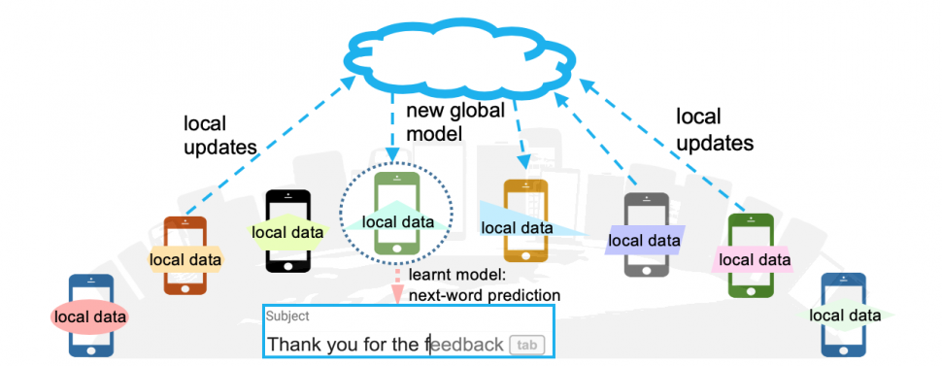
Federated Learning
A machine learning technique allows multiple parties to collaboratively train a model without data sharing.
Horizontal Federated Learning (HFL): each device has same features.

Slide 6
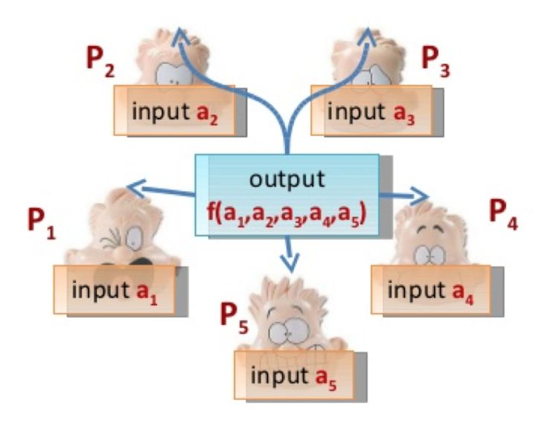
Secure Multi-Party Computation
MPC: Creating methods for parties to jointly compute a function over their inputs while keeping those inputs private.

Slide 7
Project Overview
02

Slide 8

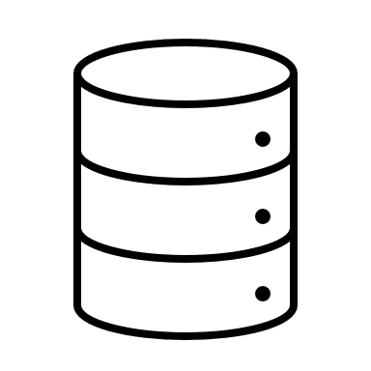



Client selection by coordinator
Party A
Party C
Party B
…
…
Client 1
Client k
Client n
Random select some clients from n clients.
Coordinator

Slide 9
Selected clients train their model with local data
Party A
Party C
Party B
…
…
Client 1
Client k
Client n
Coordinator

Slide 10
Local model broadcast
Ports: 1B,…,kB,…,nB
Party A
Party C
Party B
Ports: 1A,…,kA,…,nA
Ports: 1C,…,kB,…,nB
…
…
Client 1
Client k
Client n

Slide 11
MPC: secret adding
Party A
Party C
Party B
…
…
Client 1
Client k
Client n

Slide 12
Global model feedback
Party A
Party C
Party B
…
…
Client 1
Client k
Client n

Slide 13
Global model send back to Coordinator
Party A
Party C
Party B
…
…
Client 1
Client k
Client n
Global model
Only the first selected client do the sending.
Coordinator

Slide 14
Broadcast global model
Party A
Party C
Party B
…
…
Client 1
Client k
Client n
Global model
Global model
Global model
Coordinator broadcast global model to all not selected clients.
Coordinator

Slide 15
Implementation Details
03

Slide 16
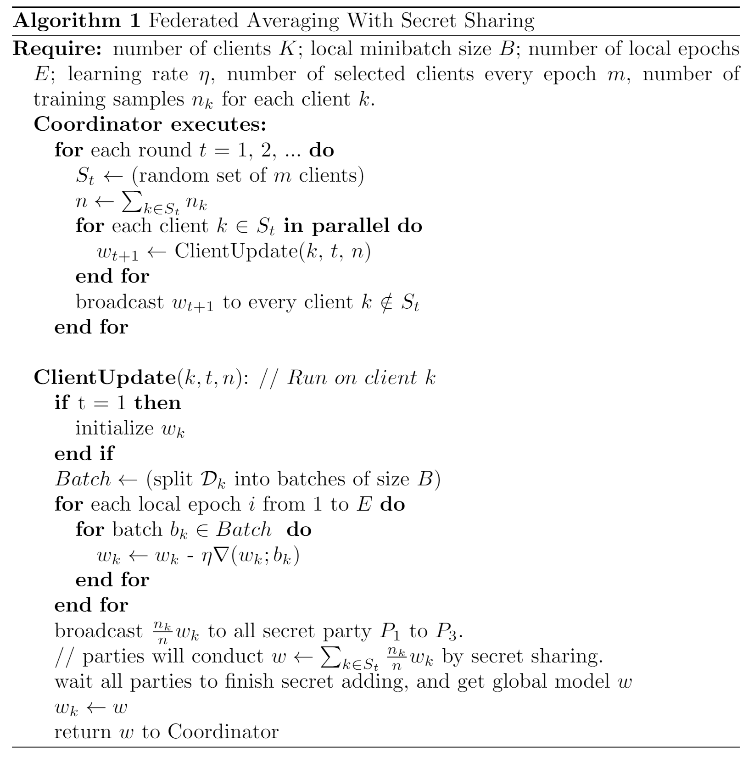
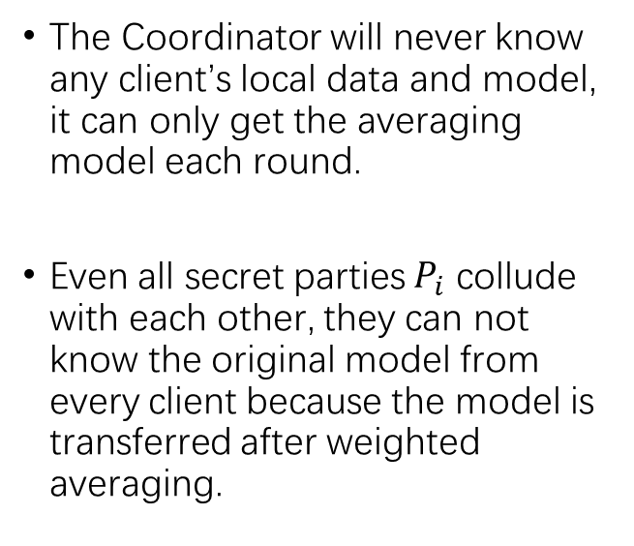
Fedrated Averaging with Secret Sharing
The Coordinator will never know any client’s local data and model, it can only get the averaging model each round.
Even all secret parties $P_{i}$ collude with each other, they can not know the original model from every client because the model is transferred after weighted averaging.

Slide 17
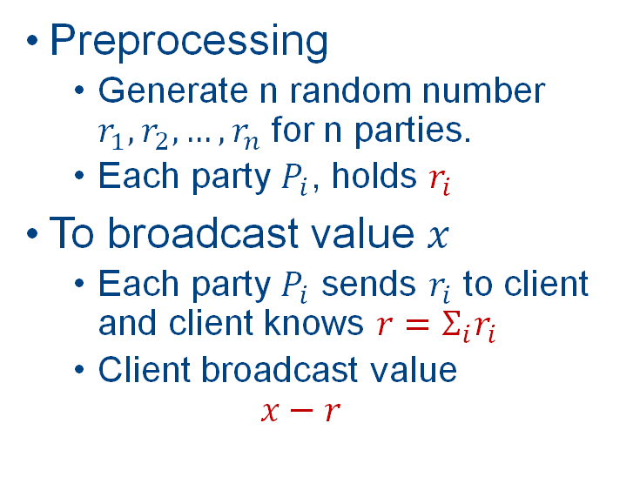
Local model broadcast [2]
Preprocessing
Generate n random number $r_{1},r_{2},…,r_{n}$ for n parties.
Each party $P_{i}$, holds $r_{i}$
To broadcast value $x$
Each party $P_{i}$ sends $r_{i}$ to client and client knows ${{r=Σ}_{i}r}_{i}$
Client broadcast value
$$x−r$$
Party A
Party C
Party B
Port: 1B
Port: 1A
Port: 1C
Client

Slide 18
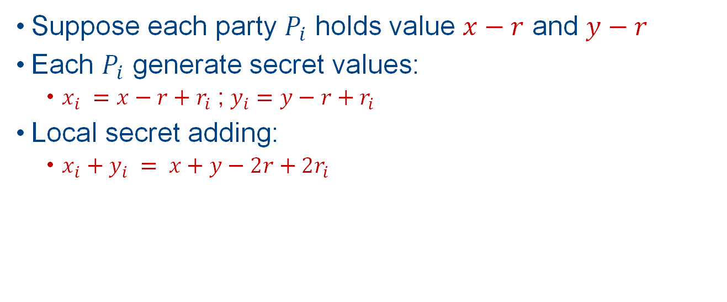
MPC: Secret adding [3]
Suppose each party $P_{i}$ holds value $x−r$ and $y−r$
Each $P_{i}$ generate secret values:
$x_{i} =x−r+r_{i}$ ; $y_{i}=y−r+r_{i}$
Local secret adding:
$x_{i}+y_{i} = x+y−2r+{2r}_{i}$
Party A
Party C
Party B

Slide 19
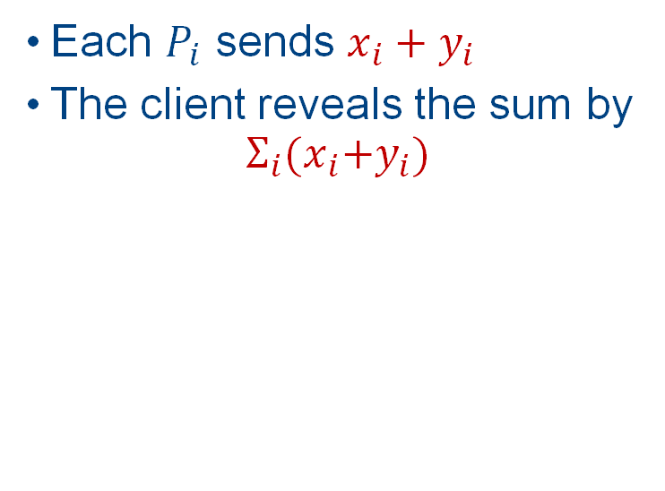
Global model feedback [2]
Each $P_{i}$ sends $x_{i}+y_{i}$
The client reveals the sum by
$$Σ_{i}{(x}_{i}+y_{i})$$
Party A
Party C
Party B
What if some parties lie?
Client
Use Beaver triples

Slide 20
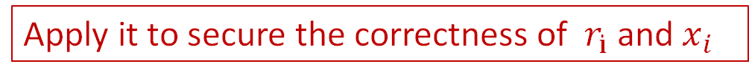
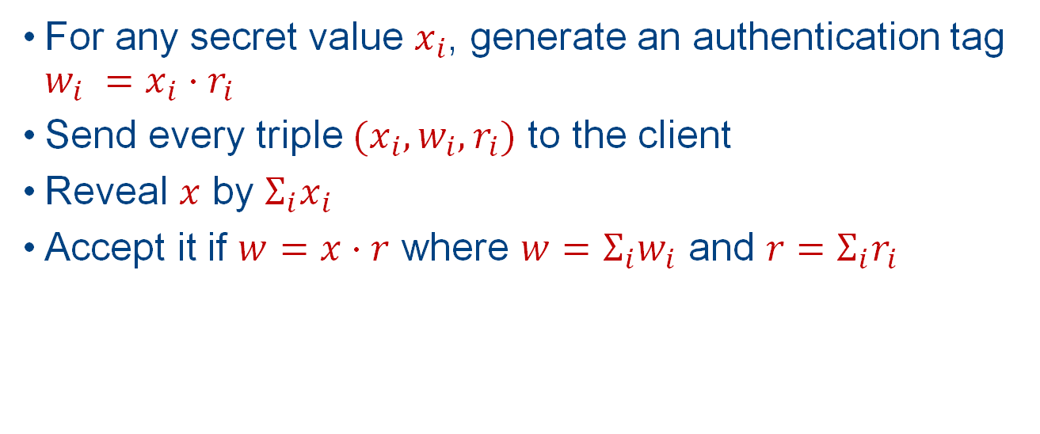
Beaver Triples [4]
For any secret value $x_{i}$, generate an authentication tag ${w_{i} =x_{i}⋅r}_{i}$
Send every triple ${(x}_{i},w_{i},r_{i})$ to the client
Reveal $x$ by $Σ_{i}x_{i}$
Accept it if $w=x⋅r$ where ${w=Σ_{i}w}_{i}$ and ${r=Σ_{i}r}_{i}$
Apply it to secure the correctness of $r_{i}$ and $x_{i}$

Slide 21
Demo
04

Slide 22
Demo setting
We don't use existing Federated Learning frameworks such as PySyft or FATE.
We implemented our platform and the network communication process all by ourselves.
Then we can manipulate all the underlying structures of our programs and know deeply about how federated learning and secret sharing works.

Slide 23
Demo setting
Two real machine: Naibo Wang’s Laptop A (172.26.186.87), Shiqi Zhang’s Server B (172.28.176.153)
Network Communication Protocol: RPC, Socket.
Environment details:
Video
Role | IP | Port
Worker 0 | 172.26.186.87 (A) | 50001
Worker 1 | 172.28.176.153 (B) | 50002
Worker 2 | 172.28.176.153 (B) | 50003
Worker 3 | 172.28.176.153 (B) | 50004
Coordinator | 172.26.186.87 (A) | 50000
Secret Party A | 172.28.176.153 (B) | 14001
Secret Party B | 172.28.176.153 (B) | 14002
Secret Party C | 172.28.176.153 (B) | 14003

Slide 24
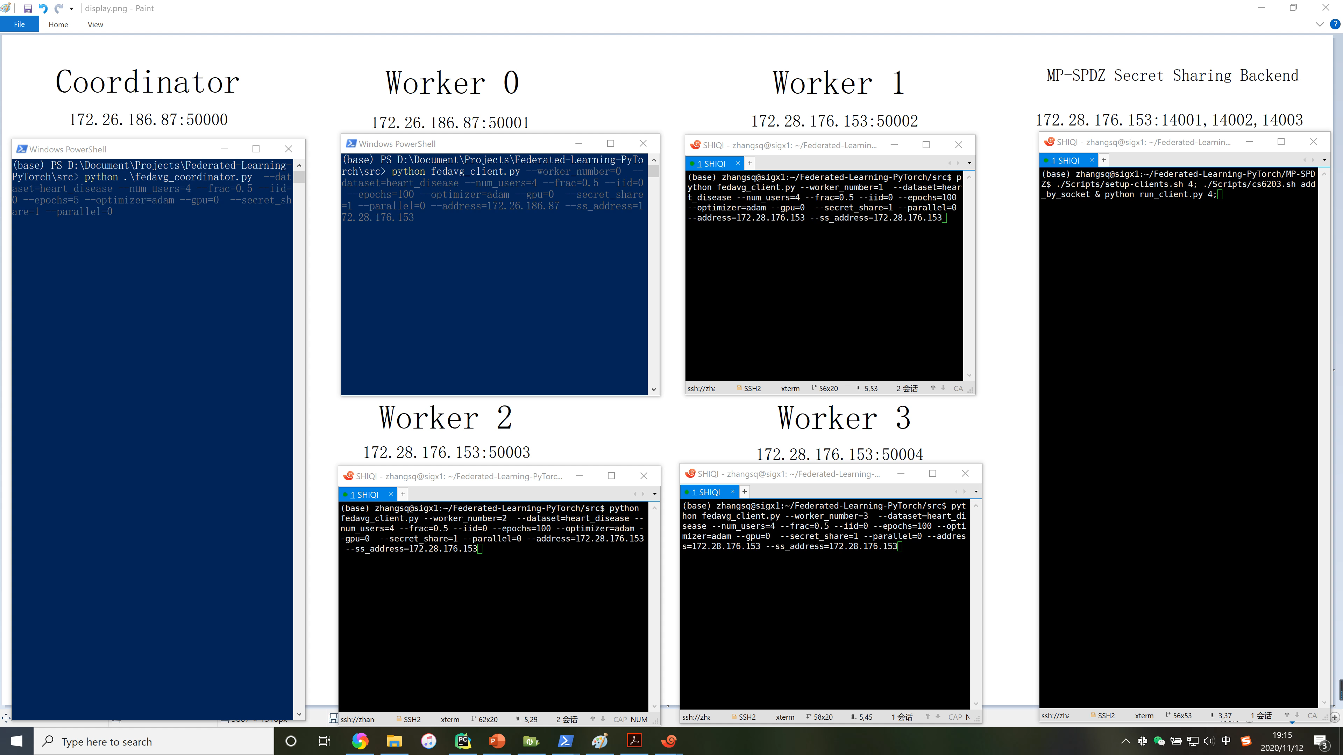
Demo display
Two real server: A (172.26.186.87), B (172.28.176.153)

Slide 25
Experiments
05

Slide 26
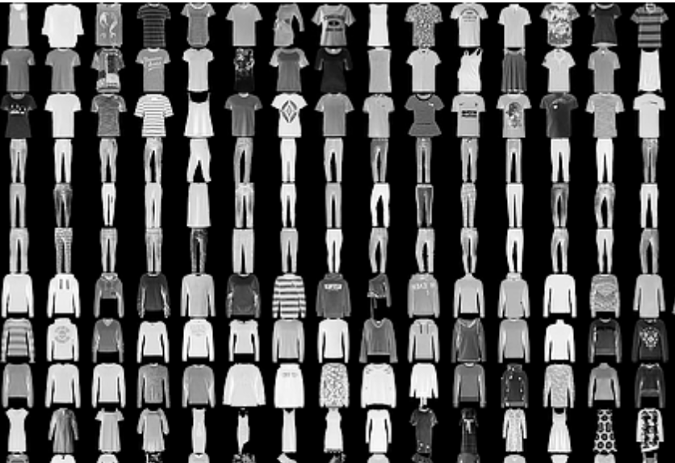
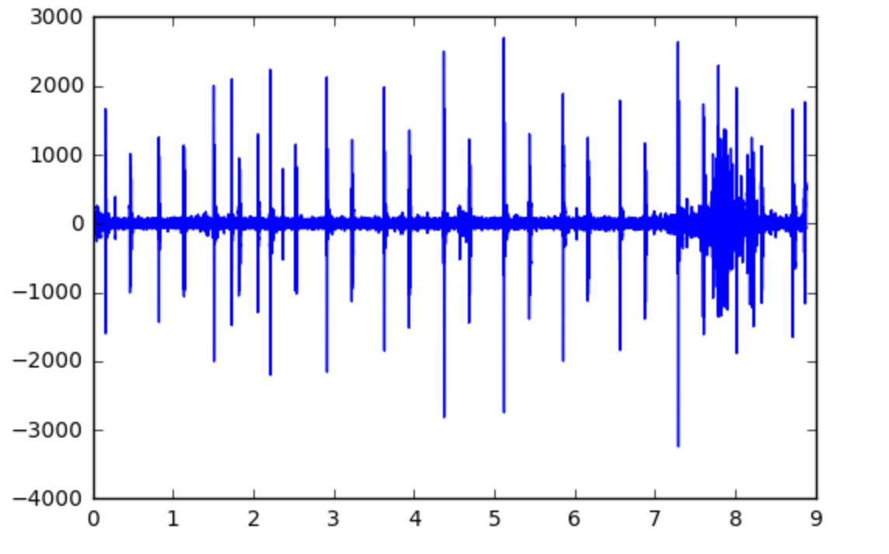
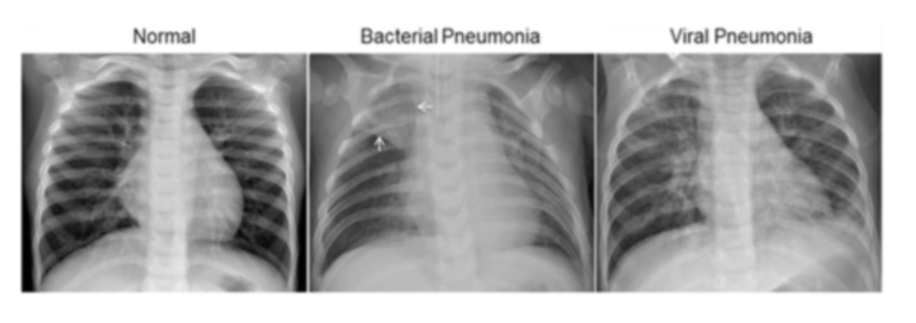
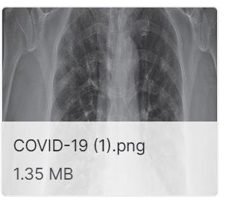
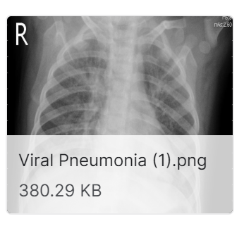
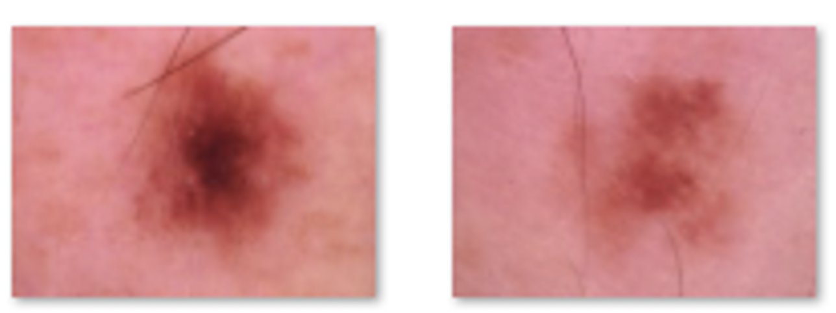
Datasets and models
Focus on classification task
Dataset [8] - [17] | Datasize | Model | Description
mnist | 70,000 (52.4M) | CNN | handwritten number
femnist | 70,000 (52.4M) | CNN | clothes
cifar10 | 60,000 (177M) | CNN | objects
chest_xray | 5,840 (1.14G) | CNN | xray images of chests
COVID19 | 2,905 (1.17G) | CNN | COVID-19 radiography images
malaria_cell | 27,558 (317M) | CNN | cell to detect malaria
HAM10000 | 10,015 (2.57G) | CNN (DenseNet) | skin images
heart_disease | 303 (12K) | MLP | human info
COVID19_twitter | 2,756 (466K) | LSTM | tweets about COVID19
heartbeat | 832 (152M) | LSTM | heart-beat sound

Slide 27
Experiment Settings
Optimizer: Adam
Dataset: All 10 datasets.
Dataset Split: Both IID and Non-IID, training set 70%, test set 30%.
Worker number: Simulated 100 users and deployed in real environment with 5 users.
Number of users selected per epoch: 10.
Local epochs: 5.
Local batch size: 50.
Learning rate: 0.001.
Epochs: from 100 to 300.
CPU: 72 core Intel(R) Xeon(R) Gold 6240 CPU @ 2.60GHz
GPU: 2 NVIDIA RTX 2080Ti, each with 11GB CUDA Memory
Memory: 310GB
Python version: 3.8.1, Pytorch version: 1.7.0

Slide 28
Experiment Comparison: Training Curve
Get training curves for 10 datasets:
IID_train: training accuracy for IID setting.
IID_test: test accuracy for IID setting.
Non-IID_train: training accuracy for Non-IID setting.
Non-IID_test: test accuracy for Non-IID setting.

Slide 29
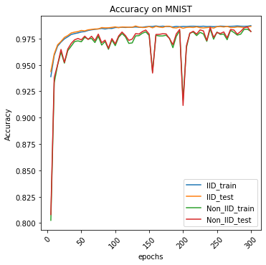
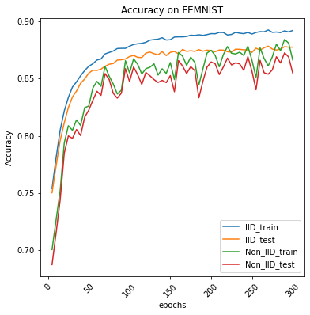
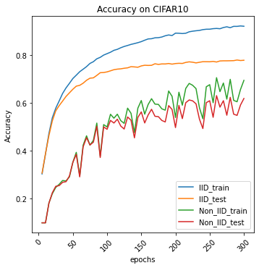
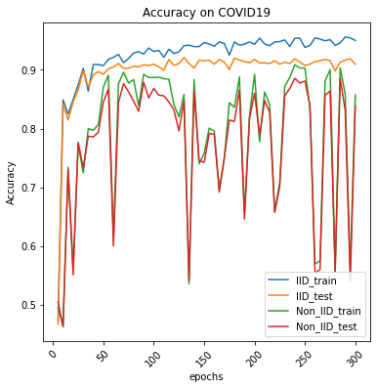
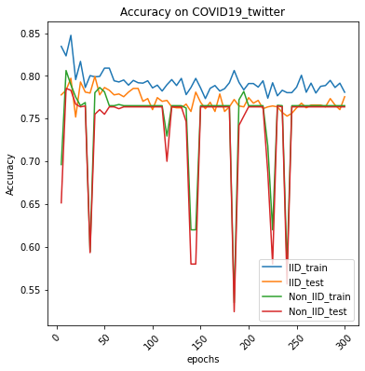
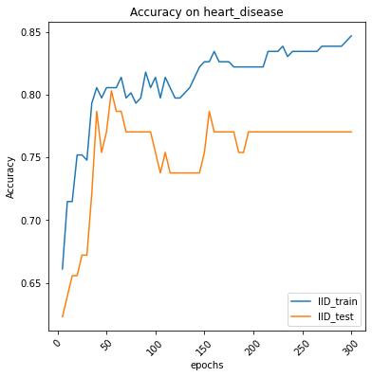
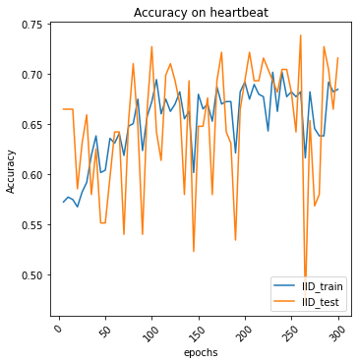
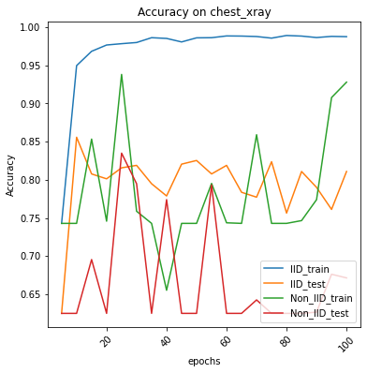
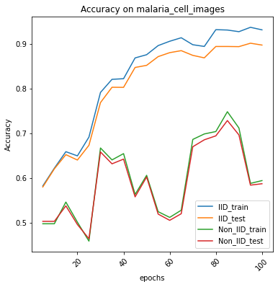
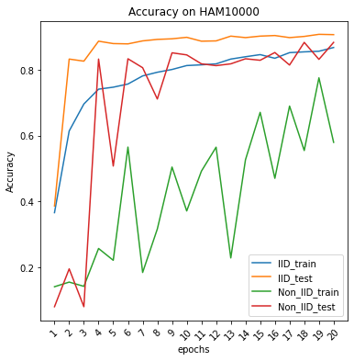
Overall, IID training accuracy > IID test accuracy > Non-IID training accuracy > Non-IID test accuracy.
IID training curves are smooth, while Non-IID curves fluctuate a lot, which means IID settings are more stable to models.
* For heart_disease and heartbeat dataset, since the data amount is relatively small, so there is no Non-IID setting.

Slide 30
Experiment Comparison: Training Curve
Images (CNN) Text contents (LSTM) Structural data (MLP) Audio data (LSTM)
Different types of data show different training trends, data preprocess is very important.
For sequence data (e.g., audio data), curve fluctuates more than other types of data, not as stable as images.
All models training on 10 datasets will converge finally, but accuracies still can be improved for some models.
A good model structure as well as its hyper parameters are very important for training models.

Slide 31
Experiment Comparison: Max Accuracy
Get max test accuracies in the following models:
Baseline: model trained on a single machine with all dataset.
FedAvg_IID: global model trained on federated setting with IID dataset partition.
FedAvg_Non_IID: global model on federated setting with Non-IID dataset partition.
FedAvg_single_IID: single model trained on federated setting with IID dataset partition.
FedAvg_single_Non_IID: single model trained on federated setting with IID dataset partition.
* Global model means the model after averaging per round.
* Single model means every client’s local model before averaging per round.
* We test all selected clients’ single models and get the average of these test accuracies.

Slide 32
Experiment Comparison: Max Accuracy
Basically, Baseline > FedAvg_IID > FedAvg_NonIID > FedAvg_single_IID > FedAvg_single_Non_IID.
In some cases, FedAvg_single_IID setting better than FedAvg_Non_IID.
Global model is obviously better than single model, which proves the needs for federated learning.

Slide 33
Experiment Comparison: Number Of Users
Setting A: 100 users, 10 users selected every epoch.
Setting B: 5 users, 3 users selected every epoch.
Dataset | Setting A Accuracy | Setting B Accuracy
Femnist | 0.8783 | 0.8948
CIFAR10 | 0.7779 | 0.8131
COVID19 | 0.9209622 | 0.922
Malaria_cell_images | 0.9204 | 0.9357
COVID19_twitter | 0.7993 | 0.824
Setting B is better than setting A.
Each user from setting B has more data than setting A, thus provide better performance.

Slide 34
Efficiency: secret sharing
Dataset | Secret sharing | Without Secret sharing
heart_disease | 215.47s | 20.88s
heartbeat | 1647.14s | 36.92s
femnist | 1107.81s | 164.24s
mnist | 1002.75s | 192.66s
Setting: Two clients and three parties
Y-axis: Overall FL time with secret sharing: (s)
X-axis: Total local model size of each client in 5 epochs: (MB)

Slide 35
Efficiency: Communication Cost
Dataset | Model Size | Network Transferring Time | Training time per epoch
mnist | 88KB | 2ms | 1.38s
COVID19 | 1MB | 0.017s | 6.25s
CIFAR10 | 13.6M | 1.37s | 37.59s
HAM10000 | 27.8M | 2.59s | 21min
In LAN, averaging transferring speed is around 12MB/s, compared with local disk writing speed 300MB/s on a single machine.
Compared with training time for each clients, the transferring time can be ignored for both small and big models.

Slide 36
Conclusion & Our Thoughts
06

Slide 37
Conclusion & Our Thoughts
Secret sharing causes large time overhead
In mnist dataset, overall 1000 seconds for 7.5MB model
Secret sharing is lossless computing, so the model accuracy remains the same as non-secret-share setting.
Communication time can be ignored when the model is relatively small in LAN (conduct in Internet?).
IID setting performs better than Non-IID, and more stable for model training.
Data preprocess and model selection are very important for model training.
Different user numbers and fraction selected can affect model performance.
Deploy the program on Internet at various platforms, and test communication costs and detect other latent problems (such as drop off).

Slide 38
Other Information
07

Slide 39
Task Division
Literature Review (Naibo Wang, Shiqi Zhang).
Dataset preparation and processing (Naibo Wang).
FedAvg model implementation with Python (Naibo Wang).
Real Distributed FedAvg model implementation with Python (Naibo Wang).
MP-SPDZ library understanding and configuration (Shiqi Zhang).
Python interface conversion from C++ secret sharing library (Shiqi Zhang).
Experiment Conduct (Naibo Wang, Shiqi Zhang).
Docker environment configuration/ Command helper (Naibo Wang).
Final report/presentation slides/readme files (Naibo Wang, Shiqi Zhang).

Slide 40
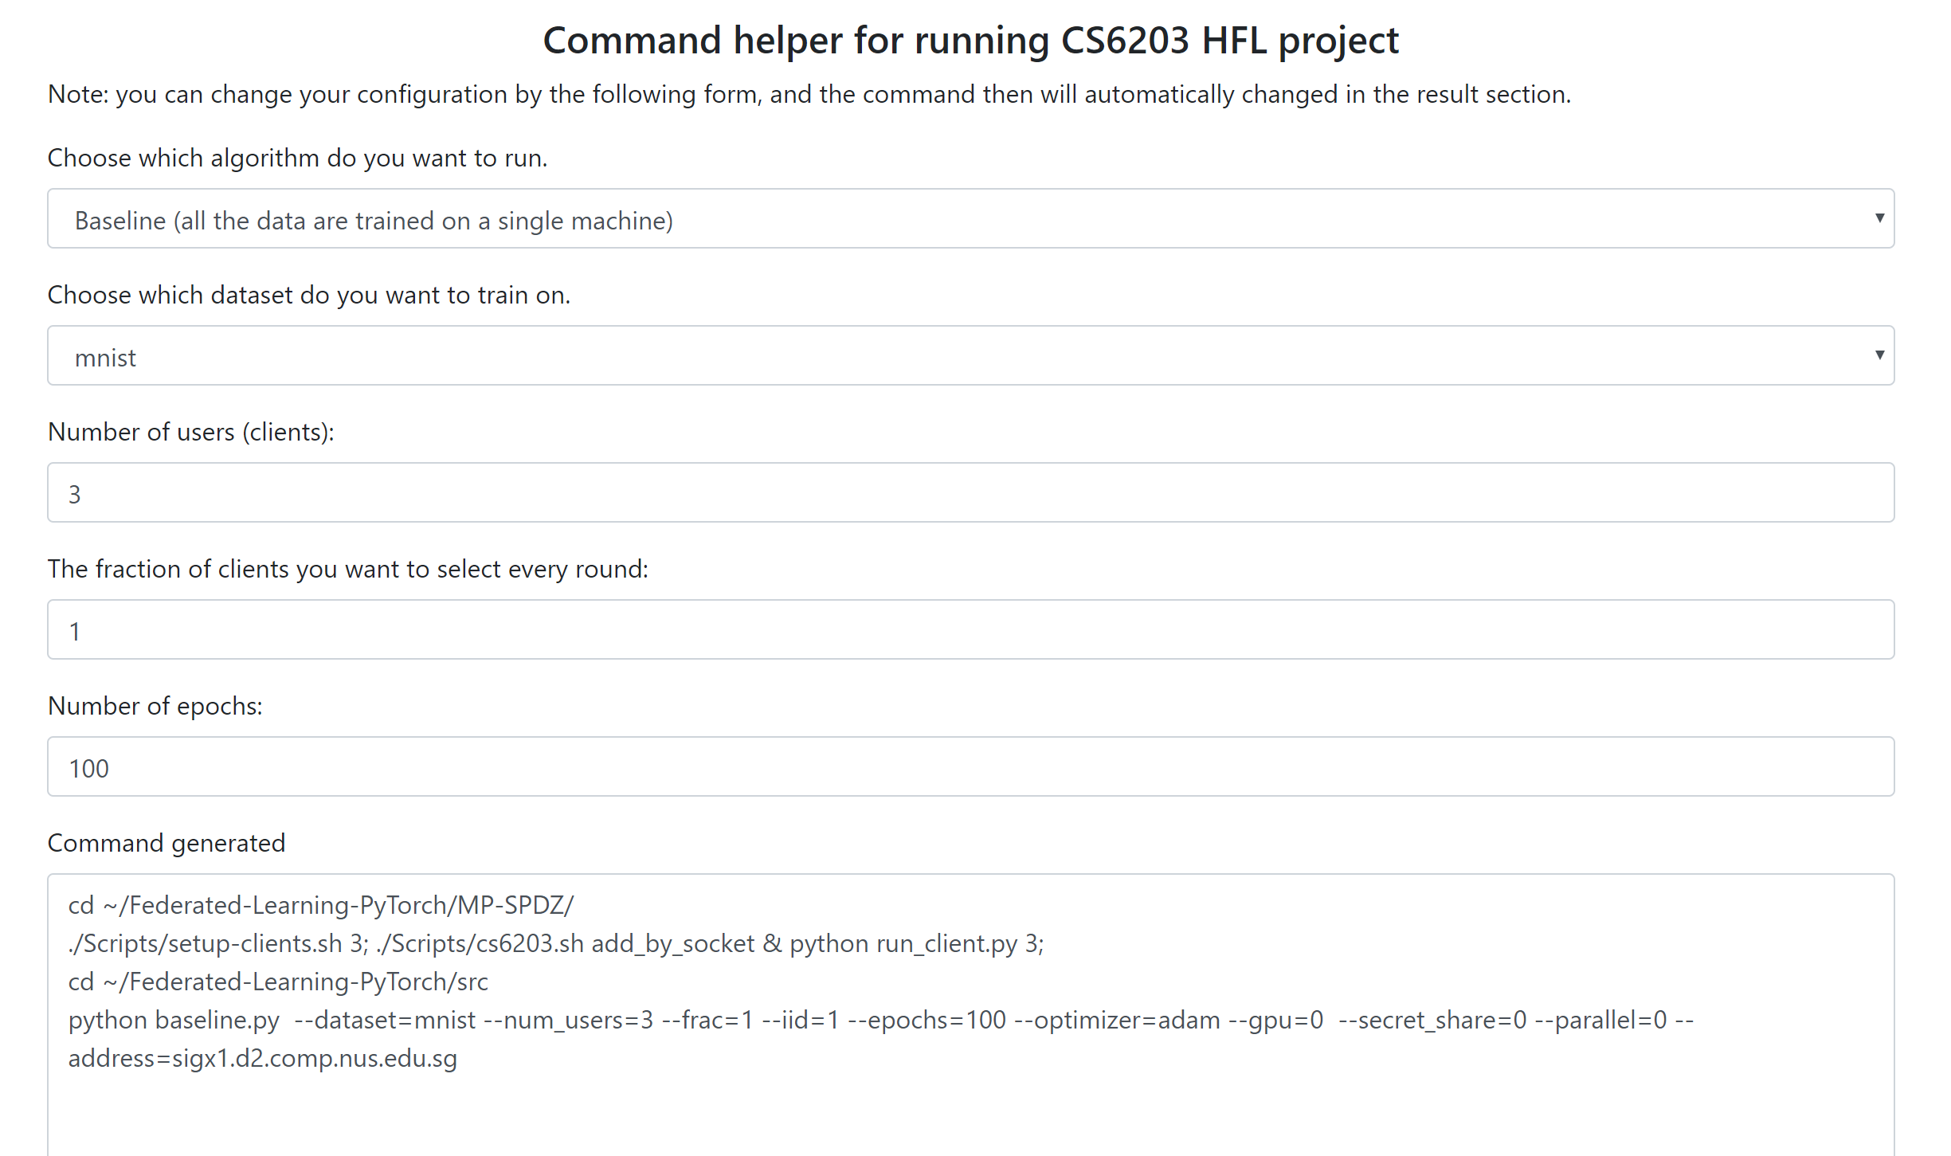
Command helper
http://naibo.wang/Projects/CS6203/commandhelper.html

Slide 41
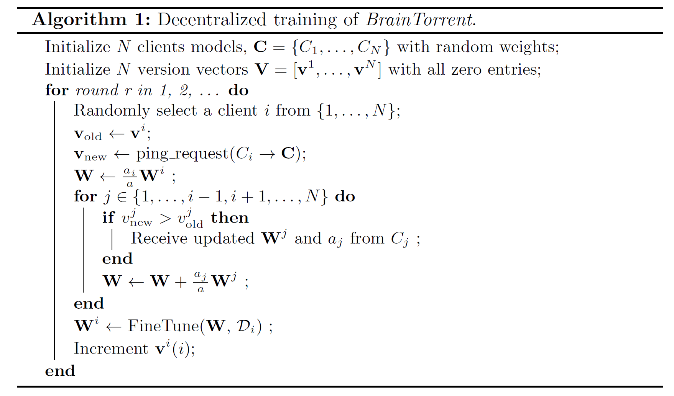
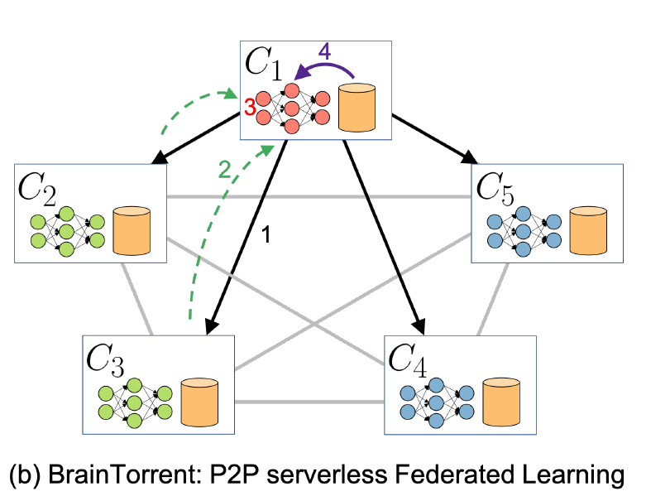
FedBrain [6]

Slide 42
Reference
[1] Keller M. MP-SPDZ: A Versatile Framework for Multi-Party Computation[J]. IACR Cryptol. 2020.
[2] Damgård, Ivan, et al. "Confidential benchmarking based on multiparty computation." International Conference on Financial Cryptography and Data Security. 2016.
[3] Damgård I, Pastro V, Smart N, et al. Multiparty computation from somewhat homomorphic encryption[C]//Annual Cryptology Conference. 2012.
[4] Beaver, D. Correlated pseudorandomness and the complexity of private computations. In Proceedings of the Twenty-Eighth Annual ACM Symposium on the Theory of Computing. 1996.
[5] McMahan B, Moore E, Ramage D, et al. Communication-efficient learning of deep networks from decentralized data[C]//Artificial Intelligence and Statistics. PMLR, 2017: 1273-1282.
[6] Roy, Abhijit Guha, et al. "Braintorrent: A peer-to-peer environment for decentralized federated learning." arXiv preprint arXiv:1905.06731 (2019).
[7] Jiang, Jingyan, and Liang Hu. "Decentralised federated learning with adaptive partial gradient aggregation." CAAI Transactions on Intelligence Technology 5.3 (2020): 230-236.
[8] Y. LeCun, L. Bottou, Y. Bengio, and P. Haffner. "Gradient-based learning applied to document recognition." Proceedings of the IEEE, 86(11):2278-2324, November 1998.

Slide 43
Reference
[9] Xiao, Han, Kashif Rasul, and Roland Vollgraf. "Fashion-mnist: a novel image dataset for benchmarking machine learning algorithms." arXiv preprint arXiv:1708.07747 (2017).
[10] Krizhevsky, Alex, and Geoffrey Hinton. "Learning multiple layers of features from tiny images." (2009): 7.
[11] Kermany, Daniel S., et al. "Identifying medical diagnoses and treatable diseases by image-based deep learning." Cell 172.5 (2018): 1122-1131.
[12] S.I. S. o. M. a. I. Radiology. (2020). COVID-19 Database. Available: https://www.sirm.org/category/senza-categoria/covid-19/
[13] https://ceb.nlm.nih.gov/repositories/malaria-datasets/
[14] Tschandl, P., Rosendahl, C. & Kittler, H. The HAM10000 dataset, a large collection of multi-source dermatoscopic images of common pigmented skin lesions. Sci. Data 5, 180161 doi:10.1038/sdata.2018.161 (2018).
[15] https://archive.ics.uci.edu/ml/datasets/Heart+Disease
[16] https://github.com/gabrielpreda/covid-19-tweets
[17] Bentley, P., et al. "Classifying heart sounds challenge." Retrieved from Classifying Heart Sounds Challenge: http://www. peterjbentley. com/heartchallenge (2011).

Slide 44
THANK YOU & QUESTIONS

Slide 45
Experiment Comparison: Training Curve
For HAM10000 datasets, since test set is relatively small than training set, so at the beginning training accuracies are lower than test accuracies.

